Slide 1
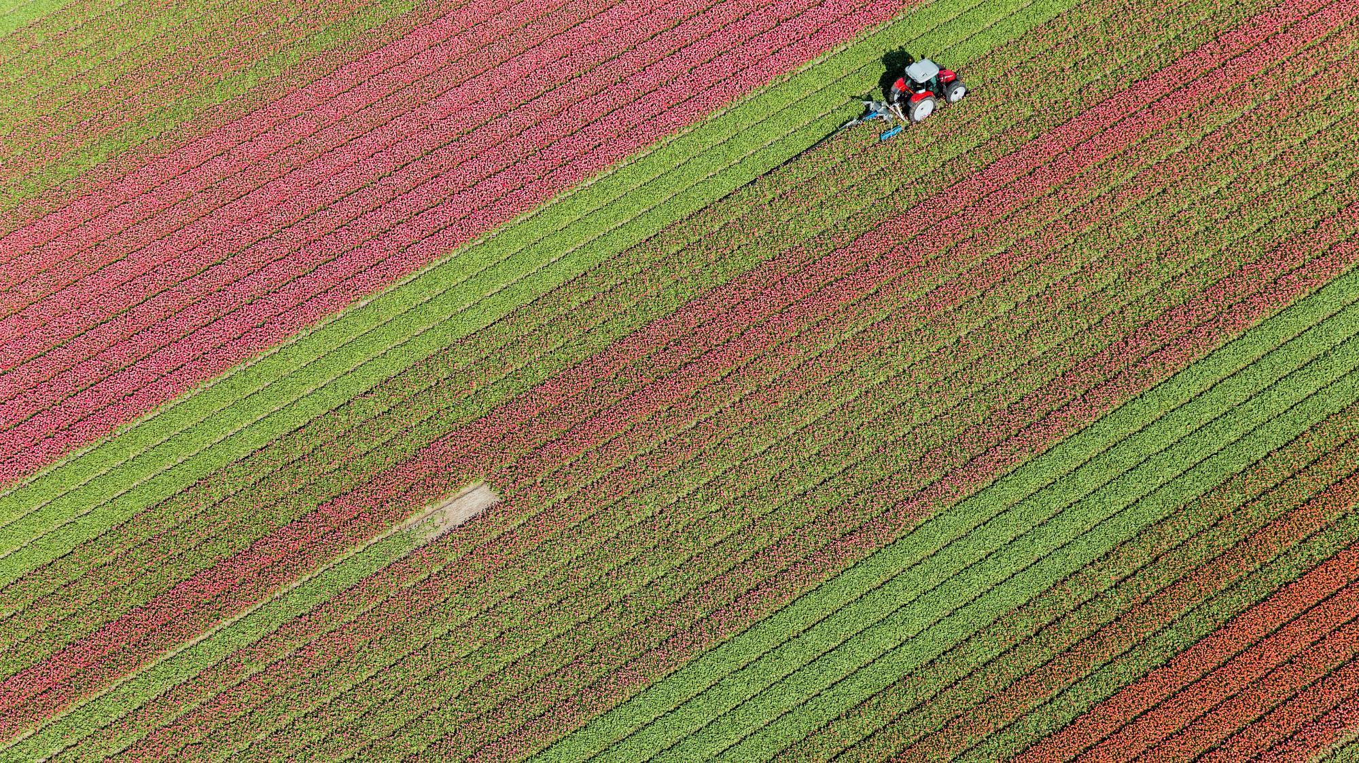
Farm Aid - for the Farm made
Team CodeKids

Slide 2

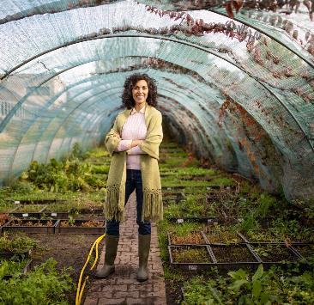
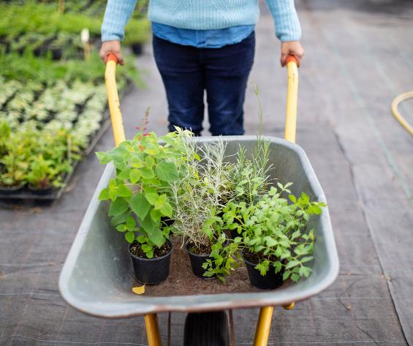
A One Step Solution to Smart Farming
Farm Aid is a website that has been designed keeping in view the opportunities of technologies in agriculture, for profit maximization
as well as
Giving a portal for farmers to directly connect with buyers and sell the crops.

Slide 3

“The ultimate goal of farming is not the growing of crops, but the cultivation and perfection of human beings.”
— Masanobu Fukuoka, 'The One-Straw Revolution', 1975

Slide 4
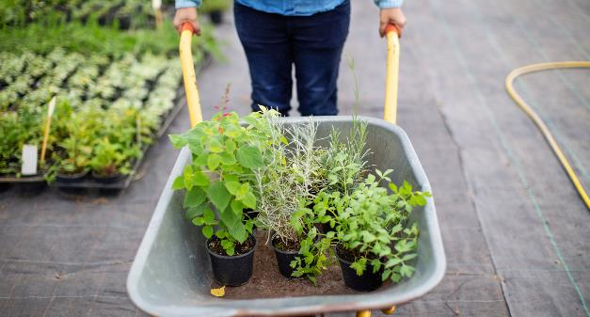
IBM Cloud Services Used
Our website is entirely Backed by IBM cloud
IBM Machine Learning
DB2
IBM IOT Platform
IBM Cognos Analytics
IBM Cloud Object Storage
Watson Assistant
Watson Studio
Node RED
IBM Auto AI
IBM Cloud Function

Slide 5


Language, Modules & Frameworks
Python 3.8
Flask
Bootstrap 5
HTML, CSS
JavaScript, jQuery
Numpy
Scikit-learn, Random Forest Regressor

Slide 6
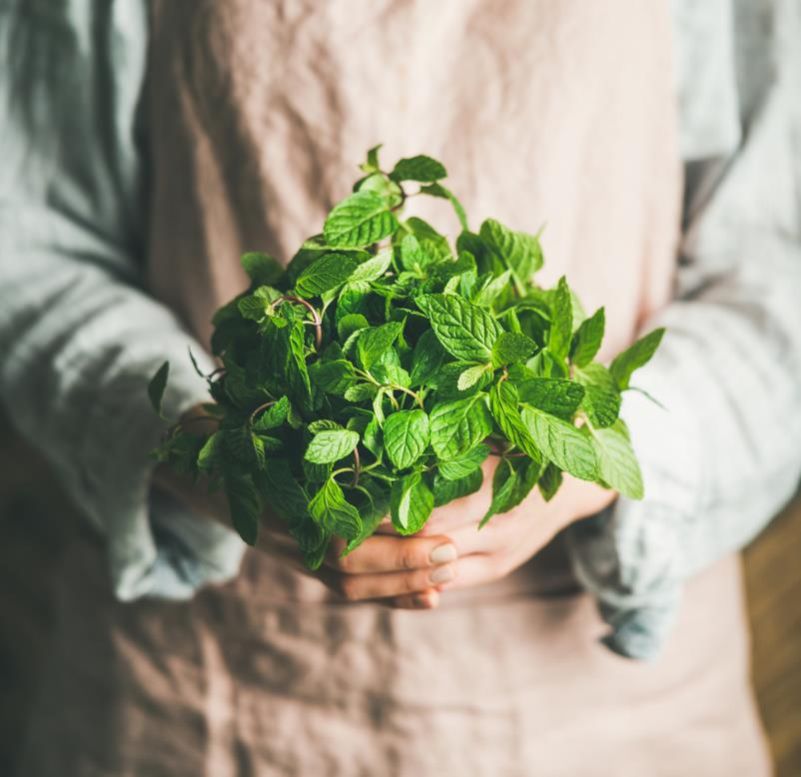
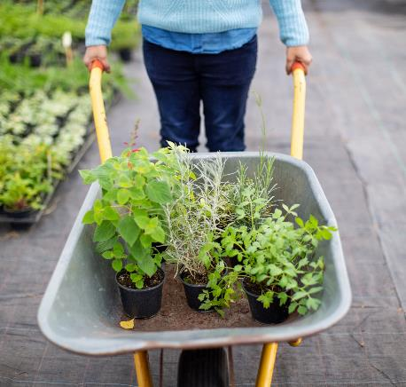
Features
Crop Recommendation
Yield Prediction
Famer- Buyer Connect Portal
Farm Board
Chatbot service

Slide 7
Our Team
Ashish Sureka
Deekshya Dash
Sanjam Kumar Panda
Debidutta Dash

Slide 8


Token of Gratitude
SmartInternz
IBM

Slide 9

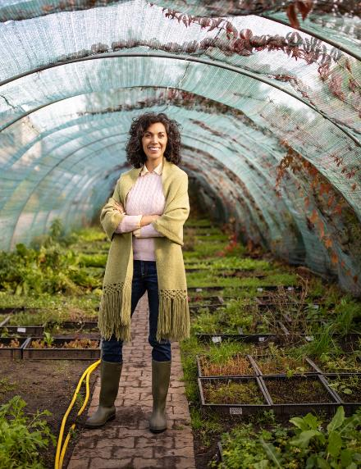
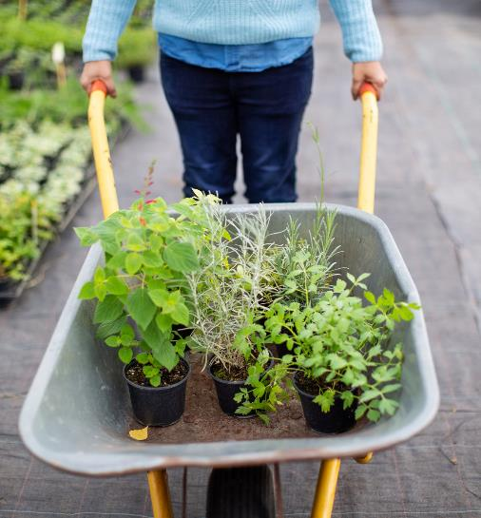

Thank You
Team CodeKids
Email: farmaid@gmail.com
Website: farmaid.xyz

Slide 10
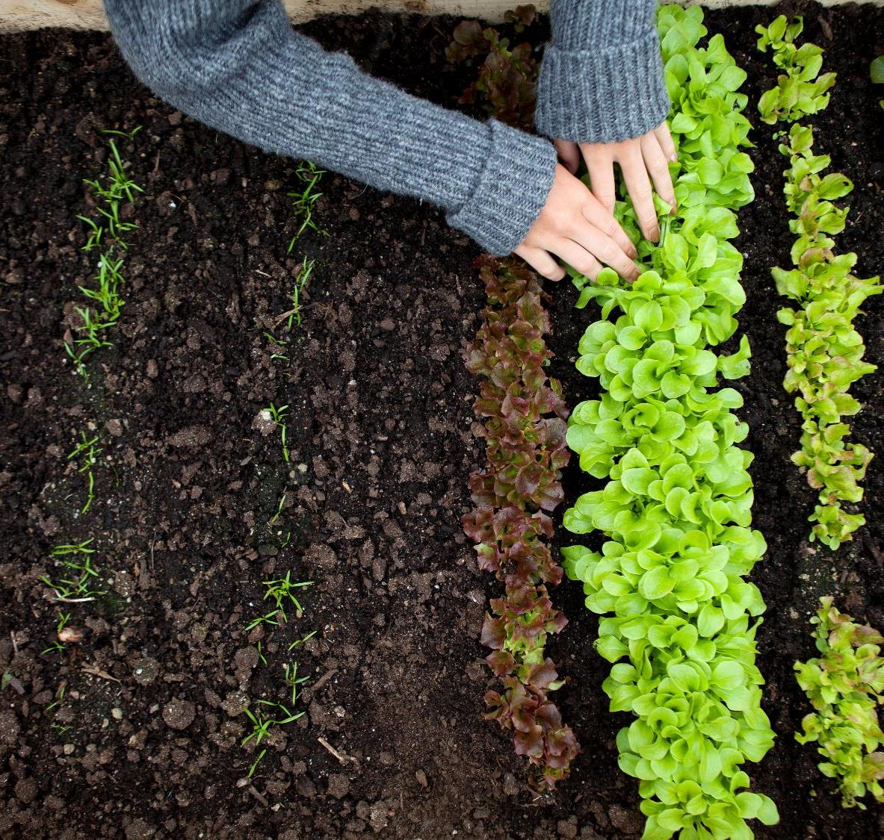
UI

